Slide 1
Chapter 18
Machine translation

Slide 2




Machine translation as a task
Machine translation can be formulated as an optimization problem
is a sentence in a source language
is a sentence in the target language
is a scoring function.
This formalism requires two components:
A decoding algorithm for computing
A learning algorithm for estimating the parameters of the scoring function Ψ.

Slide 3
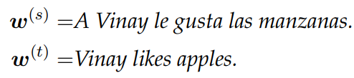
Machine translation : Labeled Data Problem
Labeled translation data usually comes in the form parallel sentences.
A useful feature function would note the translation pairs:
(gusta, likes) (manzanas, apples) (Vinay, Vinay)
Problem: Such word-to-word alignment is not given in the data.

Slide 4
Machine translation : Labeled Data Solutions
One solution is to treat this alignment as a latent variable; this is the approach taken by classical statistical machine translation (SMT) systems.
Another solution is to model the relationship between w(t) and w(s) through a complex and expressive function; like neural machine translation approach

Slide 5
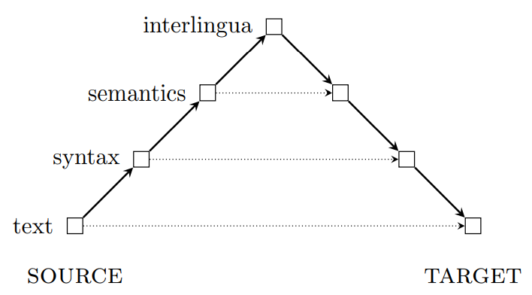
Vauquois Pyramid
The Vauquois Pyramid is a theory of how translation should be done.
At the lowest level, the translation system operates on individual words, but the horizontal distance at this level is large, because languages express ideas differently.
By moving to syntactic, the translation distance is reduced; we then need only produce target-language text from the syntactic representation.

Slide 6
Vauquois Pyramid
Further up the triangle lies semantics; translating between semantic representations should be easier still, but mapping between semantics and surface text is a difficult and unsolved problem
At the top of the triangle is interlingua, a semantic representation that is so generic that it is identical across all human languages.

Slide 7


Evaluating translations
There are two main criteria for a translation:
Adequacy: The translation should adequately reflect the linguistic content of
Fluency: The translation should read like fluent text in the target language.

Slide 8
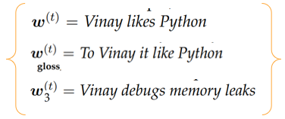


Example: Evaluating translations
Adequacy:
or word-for-word translation is adequate because it has all the relevant content.
The is not adequate base on this criteria.
Fluency: By this criterion, the gloss will score poorly, and will be preferred.

Slide 9
Evaluating translations : BLEU Score
Automated evaluations of machine translations typically merge Adequacy and Fluency criterias
Evaluations performed by comparing the system translation with some reference translations, produced by human translators.
The most popular quantitative metric is BLEU, which is based on n-gram precision.
The n-gram precisions for three hypothesis translations

Slide 10


BLEU and Brevity Penalty
One potential weakness of BLEU is that it only measures precision
The BLEU score is then based on the average →
Two modifications are necessary for
To avoid computing log0, all precisions are smoothed to ensure that they are positive
Each n-gram in the reference can be used at most once to avoid repetition.
Repetition : “to to to to to to” , Reference translation : “to be or not to be”
Problem: precision-based metrics are biased in favor of short translations.
Solution : To avoid this issue, a brevity penalty “BP” is applied to translations that are shorter than the reference

Slide 11
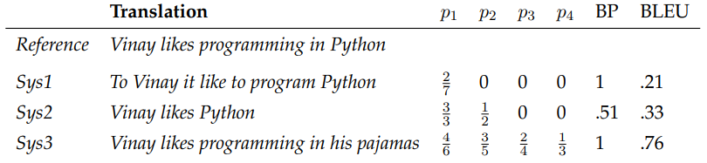
BLEU and Brevity Penalty Example
A reference translation and three system outputs.
For each output , the precision at each n-gram.
BP indicates the brevity penalty

Slide 12
Evaluating translations : BLEU Score
Automated metrics like BLEU have been validated by correlation with human judgments of translation quality.
Nonetheless, it is not difficult to construct examples in which the BLEU score is high, yet the translation is disfluent or carries a completely different meaning from the original.
Despite the importance of pronouns for semantics, they have a marginal impact on BLEU

Slide 13
Pronouns Translation.
Consider the problem of translating pronouns. Because pronouns refer to specific entities, a single incorrect pronoun can obliterate the semantics of the original sentence.
The problem of pronoun translation intersects with issues of fairness and bias
In many languages, the third person singular pronoun is gender neutral.
This bias was not directly programmed into the translation model; it arises from statistical tendencies in existing datasets
If a dataset has even a slight tendency towards men as doctors, the resulting translation model may produce translations in which doctors are always he, and nurses are always she

Slide 14
Other Translation metrics
METEOR is a weighted F -MEASURE, which is a combination of recall and precision
Translation Error Rate (TER) computes the string edit distance between the reference and the hypothesis
RIBES metric applies rank correlation to measure the similarity in word order between the system and reference translations

Slide 15
Data
Data-driven approaches to machine translation rely primarily on parallel corpora, which are translations at the sentence level.
Many languages have sizable parallel corpora with some high-resource language, but not with each other.
The high-resource language can then be used as a “pivot” or “bridge”
For example, use Spanish as a bridge for translation between Catalan and English.
For most of the 6000 languages spoken today, the only source of translation data remains the Judeo-Christian Bible.
While relatively small, at less than a million tokens, the Bible has been translated into more than 2000 languages

Slide 16



Statistical machine translation : intro
Review : Two main criteria for machine translation fluency and adequacy
A natural modeling approach is to represent them with separate scores
The fluency score need not even consider the source sentence; it only judges on whether it is fluent in the target language.
This decomposition is advantageous because it makes it possible to estimate the two scoring functions on separate data.
The fluency model can be estimated from monolingual text in the target language.
Large monolingual corpora are now available in many languages, thanks to resources such as Wikipedia.

Slide 17
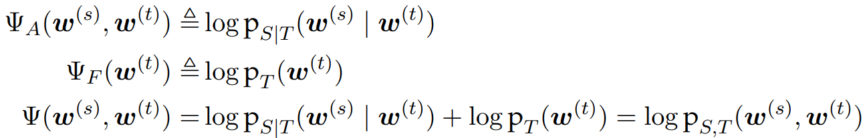



Noisy channel model
In the noisy channel model, each scoring function is a log probability
By setting the scoring functions equal to logarithms of the prior and likelihood, their sum is equal to , which is logarithm of joint probability of source and target.
The sentence that maximizes this joint probability is also the maximizer of the conditional probability , making it the most likely target language sentence, conditioned on the source.

Slide 18

Statistical translation modeling : Alignment
The simplest decomposition of the translation model is word-to-word
Each word in the source should be aligned to a word in the translation.
This approach presupposes an alignment which contains a list of pairs of source and target tokens.
Each alignment contains exactly one tuple for each word in the source
If no appropriate word in the target can be identified for a source word, it is aligned to ∅.
Words in the target can align with multiple words in the source.

Slide 19
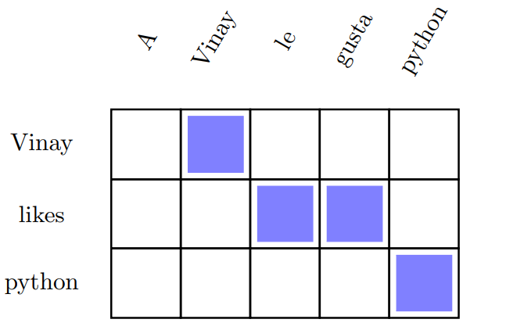

Alignment Example
Example:

Slide 20
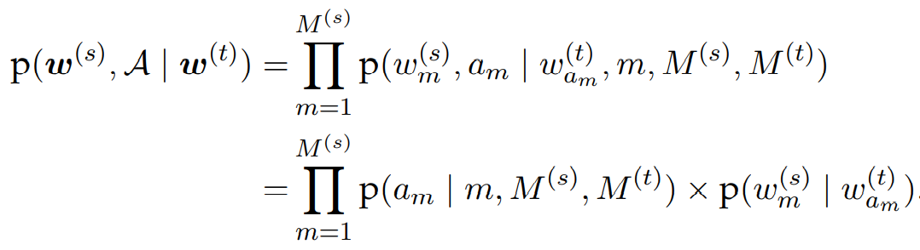
Alignment and Translation
The joint probability of the alignment and the translation:

Slide 21



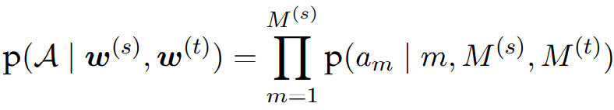
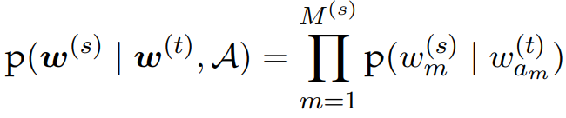
Statistical translation modeling
This probability model makes two key assumptions:
The alignment probability factors across tokens
This means that each alignment decision is independent of the others, and depends only on the index , and the sentence lengths and
The translation probability also factors across tokens
so that each word in w(s) depends only on its aligned word in w(t) . This means that translation is word-to-word, ignoring context.

Slide 22

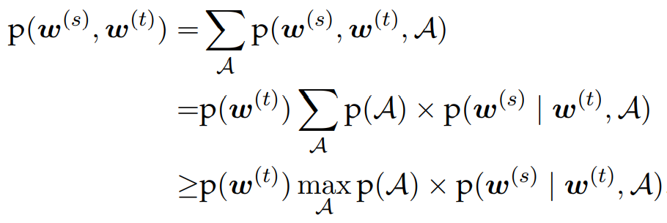
Statistical translation modeling
To translate with such a model, we could sum or max over all possible alignments
The term defines the prior probability over alignments.

Slide 23
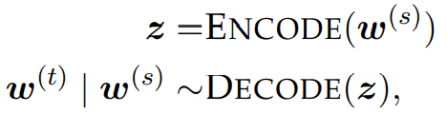


Neural machine translation
Neural network models for machine translation are based on the encoder-decoder architecture
The encoder network converts the source language sentence into a vector or matrix representation
The decoder network then converts the encoding into a sentence in the target language
Where the second line means that the function defines the conditional probability

Slide 24
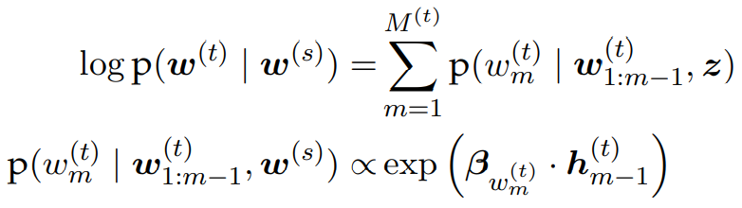
Neural machine translation
The decoder is typically a recurrent neural network, which generates the target language sentence one word at a time, while recurrently updating a hidden state.
The encoder and decoder networks are trained end-to-end from parallel sentences.
If the output layer of the decoder is a logistic function, then the entire architecture can be trained to maximize the conditional log-likelihood:

Slide 25



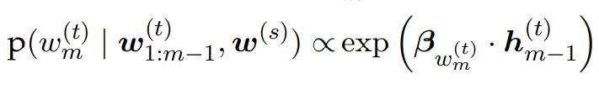
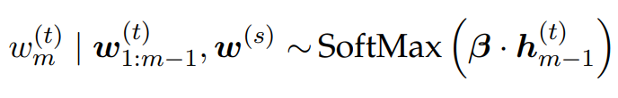


Neural machine translation
When the output layer of decoder is logistic function:
Where the hidden state is a recurrent function of the previously generated text ------ and the encoding
Where is the matrix of output word vectors for the words in the target language vocabulary.

Slide 26




Sequence-to-Sequence Model
The simplest encoder-decoder architecture is the sequence-to-sequence model
Sequence-to-sequence translation is nothing more than wiring together two LSTMs: one to read the source, and another to generate the target.
In this model, the encoder is set to the final hidden state of a long short-term memory (LSTM) on the source sentence
Where is the embedding of source language word
The encoding then provides the initial hidden state for the decoder LSTM

Slide 27
Tweaks on Sequence-to-Sequence Model
The model works better if the source sentence is reversed, reading from the end of the sentence back to the beginning.
In this way, the words at the beginning of the source have the greatest impact on the encoding z, and therefore impact the words at the beginning of the target sentence.
Advance encoding models, such as neural attention has eliminated the need for reversing the source sentence.

Slide 28

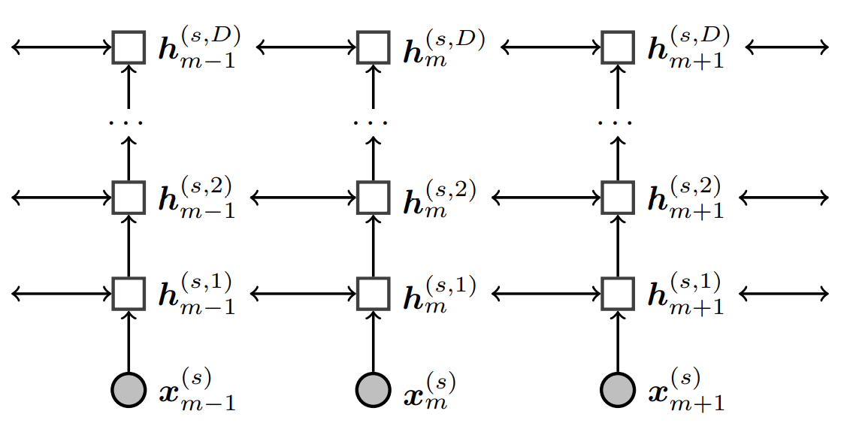

Tweaks on Sequence-to-Sequence Model : pt2
The encoder and decoder can be implemented as deep LSTMs, with multiple layers of hidden states
Each hidden state at layer i is treated as input to an LSTM at layer i + 1

Slide 29
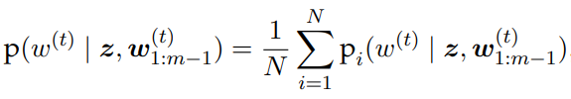
Tweaks on Sequence-to-Sequence Model : pt3
Significant improvements can be obtained by creating an ensemble of translation models, each trained from a different random initialization.
For an ensemble of size N, the per-token decoding probability is set equal to:
where is the decoding probability for model i

Slide 30
Model comparison
Statistical Translation approach is compositional
Encoder-decoder models are contextualized
Question: Is it possible for translation to be both contextualized and compositional?
Answer: Yes, One approach is to augment neural translation with an attention mechanism.

Slide 31

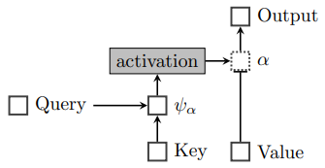
Neural Attention
Neural attention makes it possible to integrate alignment into the encoder-decoder architecture.
In general, attention can be thought of as using a query to select from a memory of key-value pairs.
However, the query, keys, and values are all vectors, and the entire operation is differentiable
A general view of neural attention:

Slide 32



Neural Attention
For each key in the memory, score gets computed with respect to the query m.
score is a function of the compatibility of key and query
can be computed using a small feedforward neural network.
The vector of scores is passed through an activation function, like SoftMax.
Output of activation function is a vector of non-negative numbers:

Slide 33





Neural Attention
Output of activation function is a vector of non-negative numbers
has length of N, equal to the size of the memory.
Each value in the memory is multiplied by the attention ; the sum of these scaled values is the output
The dotted box indicates that each can be viewed as a gate on value
Extreme case: and for all other
Then the attention mechanism selects the value from memory.

Slide 34




Neural Attention : Decoding
At each step m in decoding, attentional state is computed by executing a query, which is equal to the state of decoder, . The resulting compatibility scores :
The function is thus a two-layer feedforward neural network, with weights on the output layer, and weights on the input layer.
To convert these scores into attention weights, we apply an activation function, which can be vector-wise SoftMax or an element-wise sigmoid

Slide 35
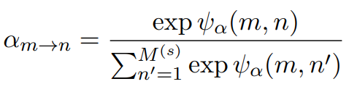
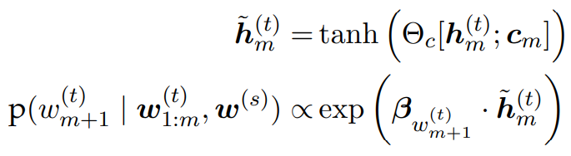
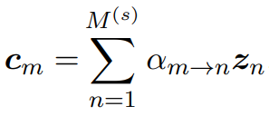







Neural Attention : Activation functions
Vector-wise SoftMax attention:
Element-wise sigmoid attention:
Attention is then used to compute a context vector by taking a weighted average over the columns of Z.
is the amount of attention from word of the target to word of the source.
The decoder state is concatenated with the context vector, forming the input to compute a final output

